Slide 1

Unit 02.01.04
CS 5220:
COMPUTER COMMUNICATIONS
Go-back-N and Selective Repeat ARQ
XIAOBO ZHOU, Ph.D.
Professor, Department of Computer Science

Slide 2
Go-Back-N with Timeout
Problem with Go-Back-N as presented:
  Window size should be long enough to cover round trip time
  If a frame is lost and transmitter does not have a frame to send, then window will not be exhausted and recovery will not commence

Slide 3
Go-Back-N with Timeout
Use a timeout with each frame
  When timeout expires, resend all outstanding frames
Time-out expires
fr
0
fr
0
fr
1
Time
A
B
Receiver is looking for R_{next} = 0
ACK1

Slide 4
Maximum Window Size
Given m-bit seq. numbers, what is the maximum number of frames that can be outstanding in “go back N”?
MAX_SEQ = 2^m – 1 while there are 2^m sequence numbers. Should the maximum number be MAX_SEQ or MAX_SEQ + 1?
Example: m = 2; sequence numbers: 0, 1, 2, 3
1) Sender sends 4 frames in a row, from 0 through 3
2) Receiver sends four corresponding ACKs back to sender, but all lost!
3) Sender times out, re-sends the 4 frames (0 through 3)
4) Receiver is waiting for frame 0
Can receiver determine whether this is a new frame 0 or an old frame 0?

Slide 5
Maximum Allowable Window Size is W_{s} = 2^{m}
M = 2² = 4, Go-Back - 4:
Transmitter goes back 4
fr
0
fr
1
fr
2
fr
3
fr
0
fr
1
fr
2
fr
3
Time
A
B
ACK1
ACK2
ACK3
ACK
0
Receiver has R_{next}= 0, but it does not know whether its ACK for frame 0 was received, so it does not know whether this is the old frame 0 or a new frame 0
R_{next} 0 1 2 3 0

Slide 6
Maximum Allowable Window Size is W_{s} = 2^{m}-1
M = 2² = 4, Go-Back-3:
Transmitter goes back 3
fr
0
fr
1
fr
2
fr
0
fr
1
fr
2
Time
A
B
ACK1
ACK2
ACK3
Receiver has R_{next}= 3 , so it rejects the old frame 0
R_{next} 0 1 2 3
The sequence of frame exchange.

Slide 7
Applications of Go-Back-N ARQ
HDLC (High-Level Data Link Control): bit-oriented data link control
V.42 modem: error control over telephone modem links

Slide 8
Piggybacking and Bidirectional Links
Since in the two-way transmission, data frames and ACK frames are interleaving, why not have a “free” ride of ACK upon a data delivering?
  Piggybacking: receiver inserts ACK in the next departing frame
  For piggybacking, how long should the data link layer wait for a packet onto which to piggyback the ACK?
Transmitter A
S_{last}
Receiver B
R_{next}

Slide 9
Required Timeout & Window Size
T_{out}
T_{proc}
T_{prop}
T_{f}
T_{f}
T_{prop}
Timeout value should allow for:
  Two propagation times + two transmission times + 1 processing time: 2 T_{prop} + 2 T_{f} + T_{proc}; Assume receiver starts transmission right after receiving
W_{s} should be large enough to keep channel busy for T_{out}

Slide 10
Window Size for Delay-Bandwidth Product
Frame = 1250 bytes =10,000 bits, R = 1 Mbps
Delay: 2(t_{prop} + t_{proc}) | Delay x BW | Window (1 + D * W / L)
1 ms | 1000 bits | 1
10 ms | 10,000 bits | 2
100 ms | 100,000 bits | 11
1 second | 1,000,000 bits | 101

Slide 11
Selective Repeat ARQ
Why Go-Back-N ARQ inefficient?
  because multiple frames are resent when errors or losses occur
  Correct but out-of-sequence frames would be discarded (because receiver buffer only 1)

Slide 12
Selective Repeat ARQ
Selective Repeat retransmits only an individual frame
  Timeout causes individual corresponding frame to be resent
  NAK causes retransmission of oldest un-acked frame
Receiver maintains a receive window of sequence numbers that can be accepted
  Receiver window is increased larger
  Error-free, but out-of-sequence frames with sequence numbers within the receive window are buffered
  Arrival of frame with R_{next} causes window to slide forward by 1 or more

Slide 13
Selective Repeat ARQ
fr
0
fr
1
fr
2
fr
3
fr
4
fr
5
fr
6
fr
2
fr
7
fr
8
fr
9
fr
10
fr
11
fr
12
Time
A
B
ACK1
ACK2
NAK2
ACK2
ACK2
ACK2
ACK7
ACK8
ACK9
ACK10
ACK11
ACK12

Slide 14
What size W_{s} and W_{r} allowed?
Example (as in Go-back N): M=2²=4, W_{s}=3, W_{r}=3
Frame 0 resent
Send Window
{0,1,2}
{1,2}
{2}
{.}
A
fr0
fr1
fr2
fr0
Time
B
Receive Window
ACK1
ACK2
ACK3
{0,1,2}
{1,2,3}
{2,3,0}
{3,0,1}
Old frame 0 accepted as a
new frame because it falls
in the receive window

Slide 15
W_{s} + W_{r} = 2^{m} is maximum allowed
Example: M=2²=4, W_{s}=2, W_{r}=2
Frame 0 resent
Send Window
{0,1}
{1}
{.}
A
fr0
fr1
fr0
Time
B
Receive Window
ACK1
ACK2
{0,1}
{1,2}
{2,3}
Old frame 0 rejected because it falls outside the receive window

Slide 16
Applications of Sel. Repeat ARQ
TCP (Transmission Control Protocol): transport layer protocol uses variation of selective repeat to provide reliable stream service
Service Specific Connection Oriented Protocol: error control for signaling messages in ATM networks

Slide 17
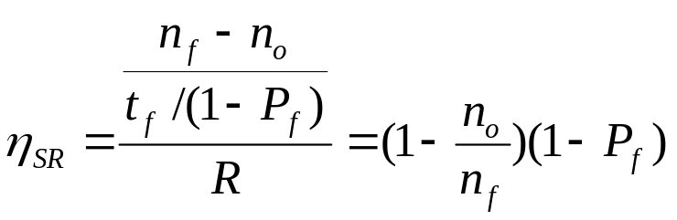
Efficiency of Selective Repeat
      t₀ = total time to transmit 1 frame
A
t_{proc}
B
t_{prop}
frame
t_{f} time (nf/R)
t_{proc}
T_{ack} (na/R)
t_{prop}
Assume P_{f} frame loss probability, then number of transmissions required to deliver a frame is 1/(1-P_{f}):
  Average transmission time: t_{f} /(1-P_{f})

Slide 18
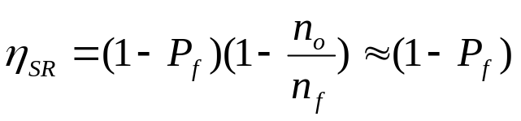
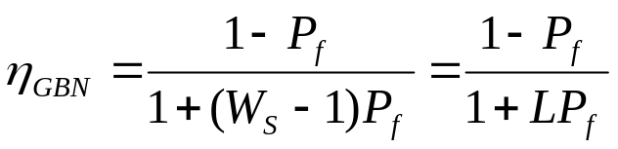
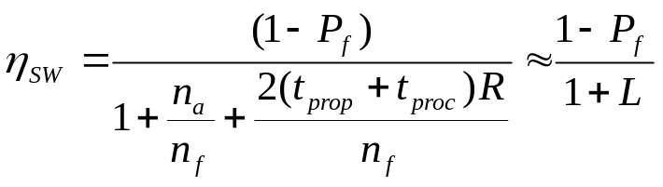
Comparison of ARQ Efficiencies
Assume n_{a}, n_{o} are negligible relative to n_{f}, and L = 2(t_{prop}+t_{proc})R/n_{f} , W_{s}= L+1
Selective-Repeat:
Go-Back-N:
For P_{f}≈0, SR & GBN same
For P_{f}→1, GBN & SW same
Stop-and-Wait:

Slide 19
Summary: Impact Bit Error Rate on ARQ
n_{f}=1250 bytes = 10000 bits, n_{a}=n_{o}=25 bytes = 200 bits
Compare S&W, GBN & SR efficiency for random bit errors with p=0, 10⁻⁶, 10⁻⁵, 10⁻⁴ and R = 1 Mbps & 100 ms
Efficiency | 0 | 10⁻⁶ | 10⁻⁵ | 10⁻⁴
S&W | 8.9% | 8.8% | 8.0% | 3.3%
GBN | 98% | 88.2% | 45.4% | 4.9%
SR | 98% | 97% | 89% | 36%

